Slide 1
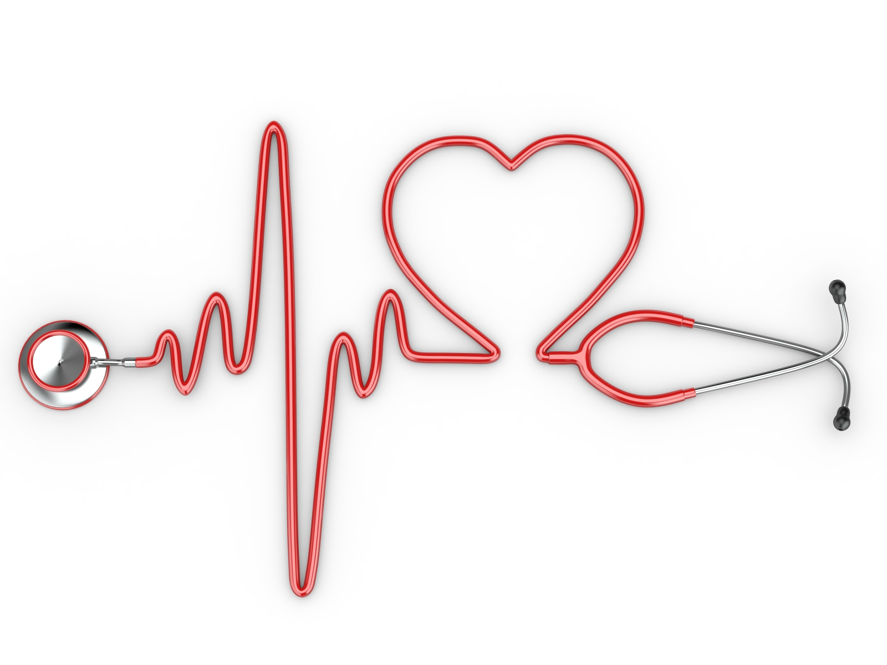
The Human Heart
&
Muscles

Slide 2

Musculoskeletal System
The musculoskeletal system provides support, stability, and movement to the body. It is made up of the bones, muscles, cartilage, tendons, ligaments, joints, and other connective tissue that supports & binds tissues and organs together.

Slide 3
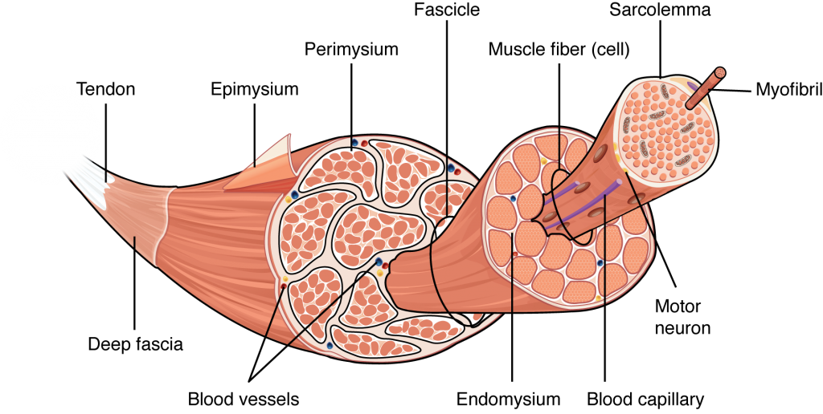
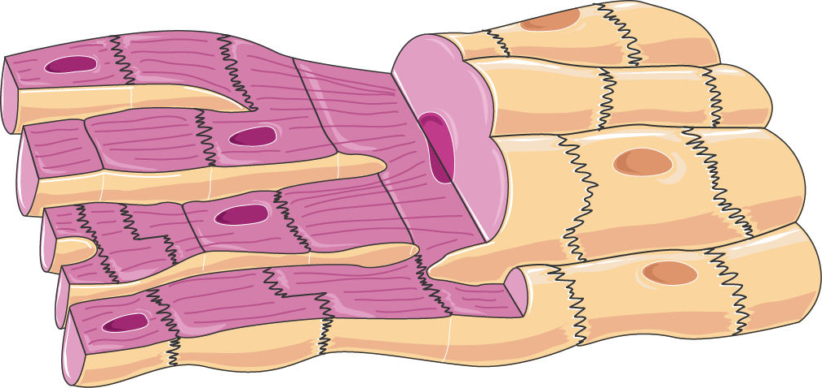
Skeletal Cells vs. Cardiac Cells
Action potential is initiated by an external stimulus
Can operate at different times
Can operate at different capacities
Autonomous action potential
Controlled by pacemaker cells
Need to operate in unison

Slide 4
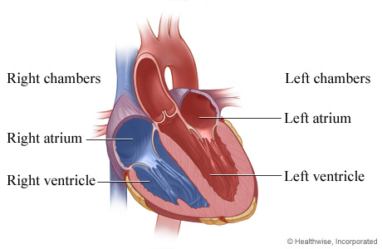
The Heart & it’s Anatomy
4 Chambers
Blood Flow
<3 → Lungs → <3 → Body → <3
Natural Pacemaker
There’s electricity in your body!

Slide 5
Function & Physiology
Fun Facts
Pumps blood
Maintains pressure gradient
Keep you alive
Blood Pressure: Systole, Diastole
Your heart is pretty much in the center of your chest
Deoxygenated blood is not blue
The sound of your heart beat are your valves opening and closing
A defibrillator isn’t turning your heart back on... but off.

